Slide 1




My Algebra Interactive Notebook
$$3ab$$
$$2x+3y$$
$$\frac{5xy}{6}$$
Name :
Class
Term 2 Semester 1
$$y=2x+1$$

Slide 2
Contents
Glossary
Page
Date
Description
2
3

Slide 3
Tasks
24
7
30
Essential Question
Questions
Notes
Summary
4
5

Slide 4
Activity- Match the Fractions
Look at the shape in the top left corner on the card you’ve just been given. Find that group.
Find a person who has the same TYPE of fraction as you do, who is not from your group.
Find another person who has the same TYPE
Find someone who has the same AMOUNT as you do. It must be a completely new person.
Find another person who has the same AMOUNT
Lastly, the 3 people who have the same AMOUNT as you do. Can you work out the total AMOUNT you have in your group of 4?
Notes:
Set

Slide 5
24
7
30
Date
Operations With Fractions
EQ – How do you add/subtract and multiply/divide fractions?
5
Notes:
Input

Slide 6
24
7
30
Date
Operations With Fractions
EQ – How do you add/subtract and multiply/divide fractions?
What steps must we follow to add/subtract fractions?
1. Make sure the denominators are the same. If not, we must find equivalent fractions that do share the same denominators.
2. Then, add or subtract the numerators. DO NOT change the denominator. It stays the same.
3. Finally, simplify your answer and convert improper fractions into mixed number fractions.
5
Notes:
Input

Slide 7

Some examples
$\frac{1}{5}+ \frac{2}{5}=$
$\frac{1}{3}+\frac{3}{5}=$
$\frac{2}{5}+\frac{11}{15}=$
3$\frac{3}{4}−$ 1$\frac{1}{2}=$
Notes:
Modelling

Slide 8

Some examples
Add the numerators
$\frac{1}{5}+ \frac{2}{5}=$ $\frac{1+2}{5}=\frac{3}{5}$
$\frac{1}{3}+\frac{3}{5}=$
$\frac{2}{5}+\frac{11}{15}=$
3$\frac{3}{4}−$ 1$\frac{1}{2}=$
Denominator stays the same
Notes:
Modelling

Slide 9

Some examples
$\frac{1}{5}+ \frac{2}{5}= \frac{1+2}{5}=\frac{3}{5}$
$\frac{1}{3}+\frac{3}{5}=$
$\frac{2}{5}+\frac{11}{15}=$
3$\frac{3}{4}−$ 1$\frac{1}{2}=$
Add the numerators
Denominator stays the same
x5
x3
x5
x3
Notes:
Modelling

Slide 10

Some examples
$\frac{1}{5}+ \frac{2}{5}= \frac{1+2}{5}=\frac{3}{5}$
$\frac{1}{3}+\frac{3}{5}= \frac{5}{15}+\frac{9}{15}=\frac{5+9}{15}=\frac{14}{15}$
$\frac{2}{5}+\frac{11}{15}=$
3$\frac{3}{4}−$ 1$\frac{1}{2}=$
Add the numerators
Denominator stays the same
x5
x3
x5
x3
Notes:
Modelling

Slide 11

Some examples
$\frac{1}{5}+ \frac{2}{5}= \frac{1+2}{5}=\frac{3}{5}$
$\frac{1}{3}+\frac{3}{5}= \frac{5}{15}+\frac{9}{15}=\frac{5+9}{15}=\frac{14}{15}$
$\frac{2}{5}+\frac{11}{15}=$
3$\frac{3}{4}−$ 1$\frac{1}{2}=$
Add the numerators
Denominator stays the same
x5
x3
x5
x3
x3
x3
Notes:
Modelling

Slide 12

Some examples
$\frac{1}{5}+ \frac{2}{5}= \frac{1+2}{5}=\frac{3}{5}$
$\frac{1}{3}+\frac{3}{5}= \frac{5}{15}+\frac{9}{15}=\frac{5+9}{15}=\frac{14}{15}$
$\frac{2}{5}+\frac{11}{15}=\frac{6}{15}+\frac{11}{15}=\frac{6+11}{15}=\frac{17}{15}$
3$\frac{3}{4}−$ 1$\frac{1}{2}=$
Add the numerators
Denominator stays the same
x5
x3
x5
x3
x3
x3
Notes:
Modelling

Slide 13

Some examples
$\frac{1}{5}+ \frac{2}{5}= \frac{1+2}{5}=\frac{3}{5}$
$\frac{1}{3}+\frac{3}{5}= \frac{5}{15}+\frac{9}{15}=\frac{5+9}{15}=\frac{14}{15}$
$\frac{2}{5}+\frac{11}{15}=\frac{6}{15}+\frac{11}{15}=\frac{6+11}{15}=\frac{17}{15}=1\frac{2}{15}$
3$\frac{3}{4}−$ 1$\frac{1}{2}=$
Add the numerators
Denominator stays the same
x5
x3
x5
x3
x3
x3
Notes:
Modelling

Slide 14
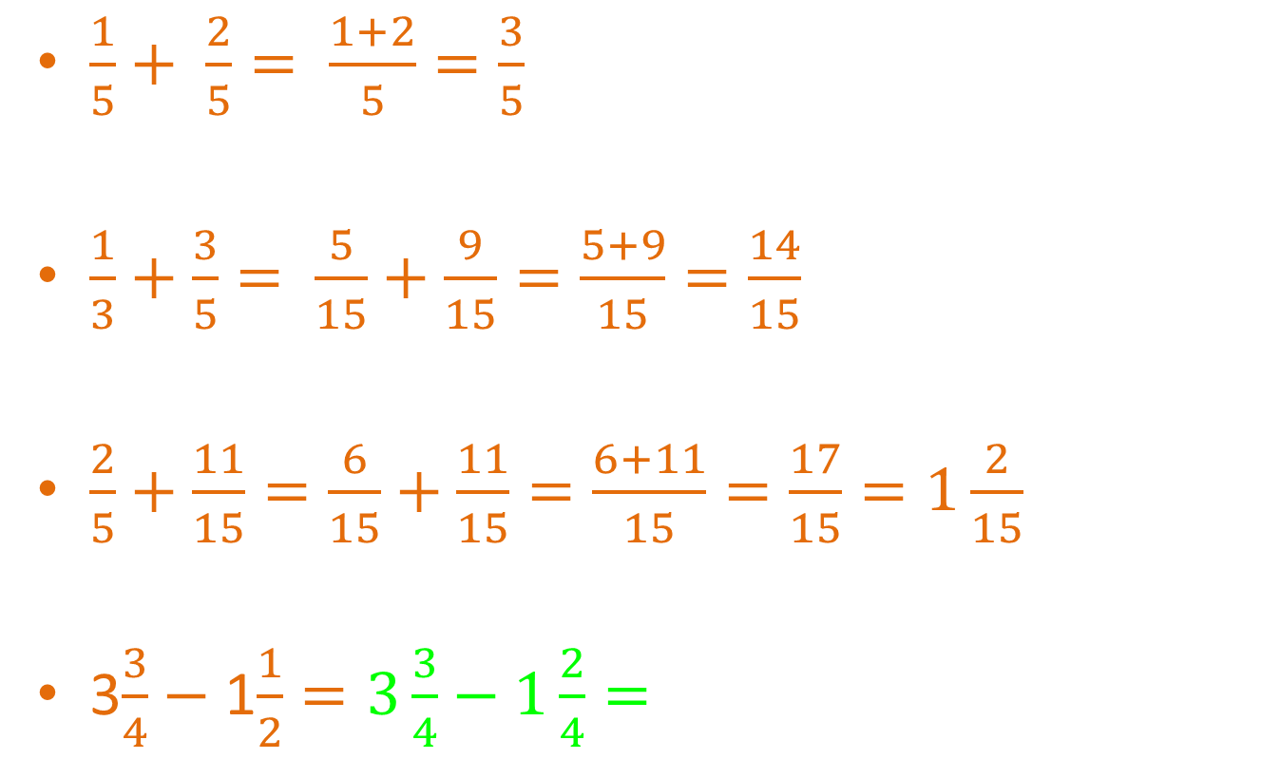
Some examples
$\frac{1}{5}+ \frac{2}{5}= \frac{1+2}{5}=\frac{3}{5}$
$\frac{1}{3}+\frac{3}{5}= \frac{5}{15}+\frac{9}{15}=\frac{5+9}{15}=\frac{14}{15}$
$\frac{2}{5}+\frac{11}{15}=\frac{6}{15}+\frac{11}{15}=\frac{6+11}{15}=\frac{17}{15}=1\frac{2}{15}$
3$\frac{3}{4}−$ 1$\frac{1}{2}=3\frac{3}{4}−1\frac{2}{4}=$
Add the numerators
Denominator stays the same
x5
x3
x5
x3
x3
x3
Only change the fraction parts
Notes:
Modelling

Slide 15
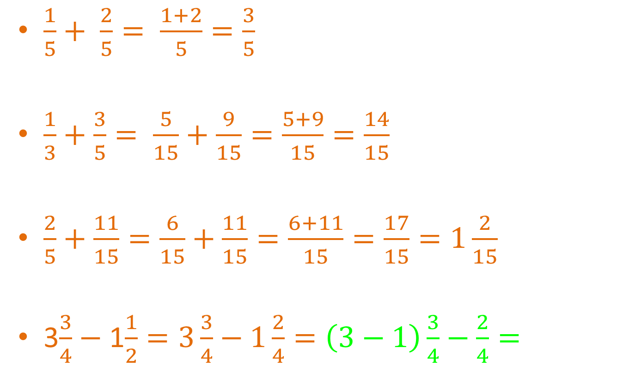
Some examples
$\frac{1}{5}+ \frac{2}{5}= \frac{1+2}{5}=\frac{3}{5}$
$\frac{1}{3}+\frac{3}{5}= \frac{5}{15}+\frac{9}{15}=\frac{5+9}{15}=\frac{14}{15}$
$\frac{2}{5}+\frac{11}{15}=\frac{6}{15}+\frac{11}{15}=\frac{6+11}{15}=\frac{17}{15}=1\frac{2}{15}$
3$\frac{3}{4}−$ 1$\frac{1}{2}=3\frac{3}{4}−1\frac{2}{4}=\left(3−1\right)\frac{3}{4}−\frac{2}{4}=$
Add the numerators
Denominator stays the same
x5
x3
x5
x3
x3
x3
Only change the fraction parts
+ or – the whole numbers
Notes:
Modelling

Slide 16
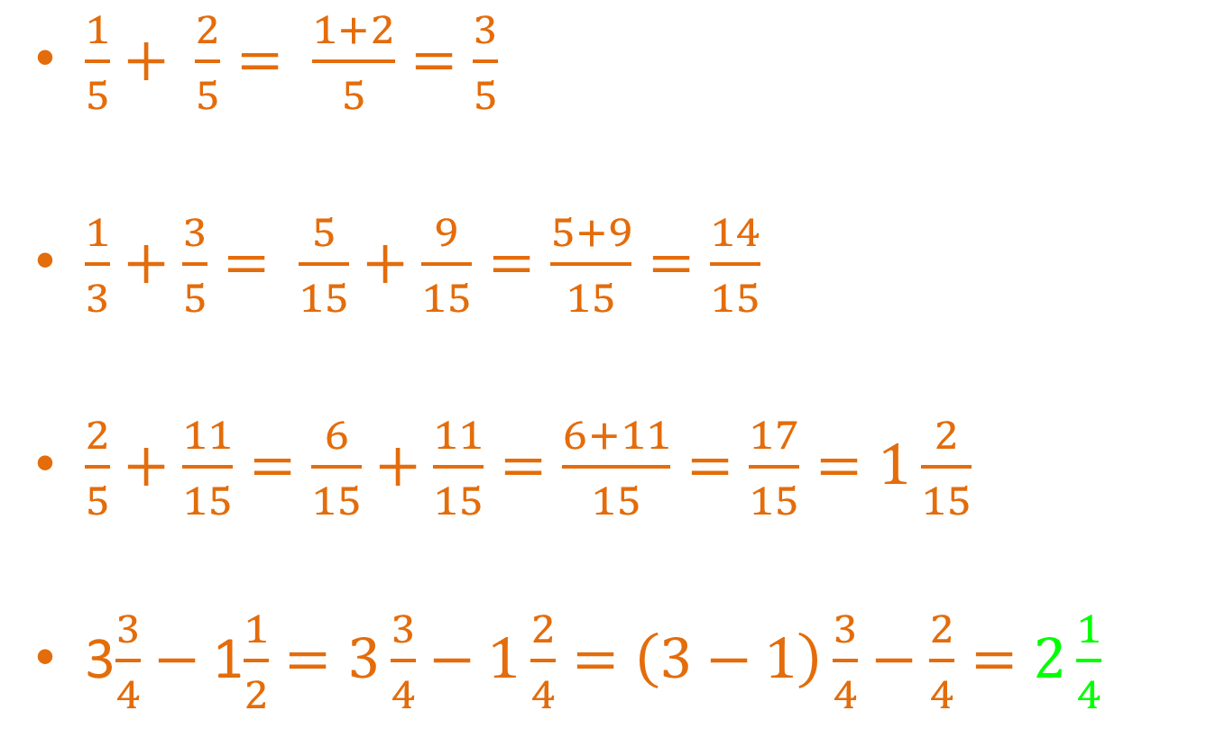
Some examples
$\frac{1}{5}+ \frac{2}{5}= \frac{1+2}{5}=\frac{3}{5}$
$\frac{1}{3}+\frac{3}{5}= \frac{5}{15}+\frac{9}{15}=\frac{5+9}{15}=\frac{14}{15}$
$\frac{2}{5}+\frac{11}{15}=\frac{6}{15}+\frac{11}{15}=\frac{6+11}{15}=\frac{17}{15}=1\frac{2}{15}$
3$\frac{3}{4}−$ 1$\frac{1}{2}=3\frac{3}{4}−1\frac{2}{4}=\left(3−1\right)\frac{3}{4}−\frac{2}{4}=2\frac{1}{4}$
Add the numerators
Denominator stays the same
x5
x3
x5
x3
x3
x3
Only change the fraction parts
+ or – the whole numbers
Notes:
Modelling

Slide 17

Do you understand? Quickfire Tips
What are 3 tips you could give someone who was trying to add/subtract with fractions?
Notes:
Check For Understanding

Slide 18

Let’s try these together
$\frac{1}{3}+\frac{5}{6}$
$\frac{3}{4}−\frac{5}{10}$
$\frac{8}{9}+\frac{1}{3}$
$3\frac{5}{8}$ $−2\frac{1}{4}$
Notes:
Guided Practice

Slide 19

24
7
30
Date
Operations With Fractions
EQ – How do you add/subtract and multiply/divide fractions?
What steps must we follow to add/subtract fractions?
1. Make sure the denominators are the same. If not, we must find equivalent fractions that do share the same denominators.
2. Then, add or subtract the numerators. DO NOT change the denominator. It stays the same.
3. Finally, simplify your answer and convert improper fractions into mixed number fractions.
What steps must we follow to multiply fractions?
You multiply the numerators together and then the denominators together.
e.g. $\frac{3}{5} × \frac{3}{4} = \frac{3×3}{5×4}= \frac{9}{20}$
Always see if you can simplify the answer
5
Notes:
Input and Modelling

Slide 20

24
7
30
Date
Operations With Fractions
EQ – How do you add/subtract and multiply/divide fractions?
What steps must we follow to add/subtract fractions?
1. Make sure the denominators are the same. If not, we must find equivalent fractions that do share the same denominators.
2. Then, add or subtract the numerators. DO NOT change the denominator. It stays the same.
3. Finally, simplify your answer and convert improper fractions into mixed number fractions.
What steps must we follow to multiply fractions?
You multiply the numerators together and then the denominators together.
e.g. $\frac{3}{5} × \frac{3}{4} = \frac{3×3}{5×4}= \frac{9}{20}$
Always see if you can simplify the answer
What steps must we follow to divide fractions?
Dividing is the same as multiplying, except you switch one of the fractions over. This flipped fraction is called the reciprocal.
e.g. $\frac{2}{3} ÷ \frac{4}{5}$ $=\frac{2}{3} × \frac{5}{4}=\frac{2×5}{3×4}= \frac{10}{12}=\frac{5}{6}$
5
Notes:
Input and Modelling

Slide 21
Do you understand? Quickfire Tips
What are 3 tips you could give someone who was trying to multiply/divide with fractions?
Notes:
Check For Understanding

Slide 22

Let’s try these together
$\frac{1}{3}×\frac{5}{6}$
$\frac{3}{4}×\frac{5}{10}$
$\frac{2}{3}÷\frac{3}{4}$
$\frac{5}{6}÷\frac{3}{4}$
Notes:
Guided Practice

Slide 23
Task
1
2
3
4
Notes:
Independent Practice

Slide 24
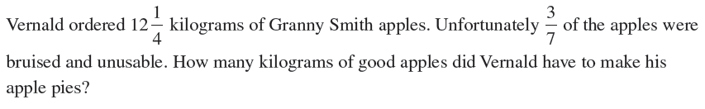
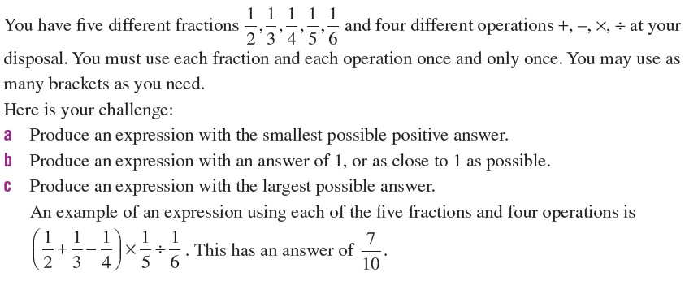
Final Challenge- Choose a problem and work together with a partner to solve
Standard Problem
Hard Problem
Notes:
Closure

Slide 25
Notes Review
24, 7 ,30
Date
Title
Essential question
Notes complete
Notes complete with colour and diagrams
Questions completed
Contents page filled in
Formula page filled in

Slide 26
Homework
Review your notes and write a summary answering the essential question.

